Slide 1
Control Flow Graph
Ashraful Islam Shanto Sikder
Roll : BSSE 1124
Supervised by : Abdus Satter

Slide 2
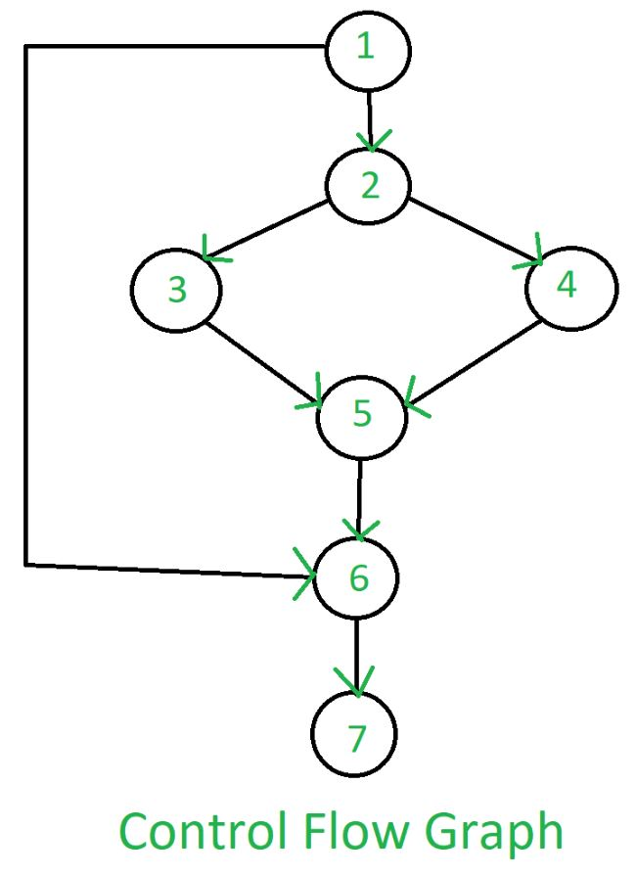
What Is Control Flow Graph?
Control Flow Graph (CFG) is a graph representation of a program.
Statements are represented by Nodes.
Statement dependency or jumps are represented by directed edges.
Image collected from geeksforgeeks.com

Slide 3
Motivations
T

Slide 4
Planned Steps
Parsing C source codes
Detecting Statements
Detecting Loops (for, while, do-while)
Detecting If-else
Implementing CFG using Linked Lists
Graphical Simulation of the generated CFG

Slide 5
Progress Till Date
Parsing C source codes
Detecting Statements
Detecting Loops (for, while, do-while)
Detecting If-else
Implementing CFG using Linked Lists

Slide 6
Things To Do Next
Implementing all the library functons that has been used
Simulating the CFG using MINIMUM library use

